Slide 1
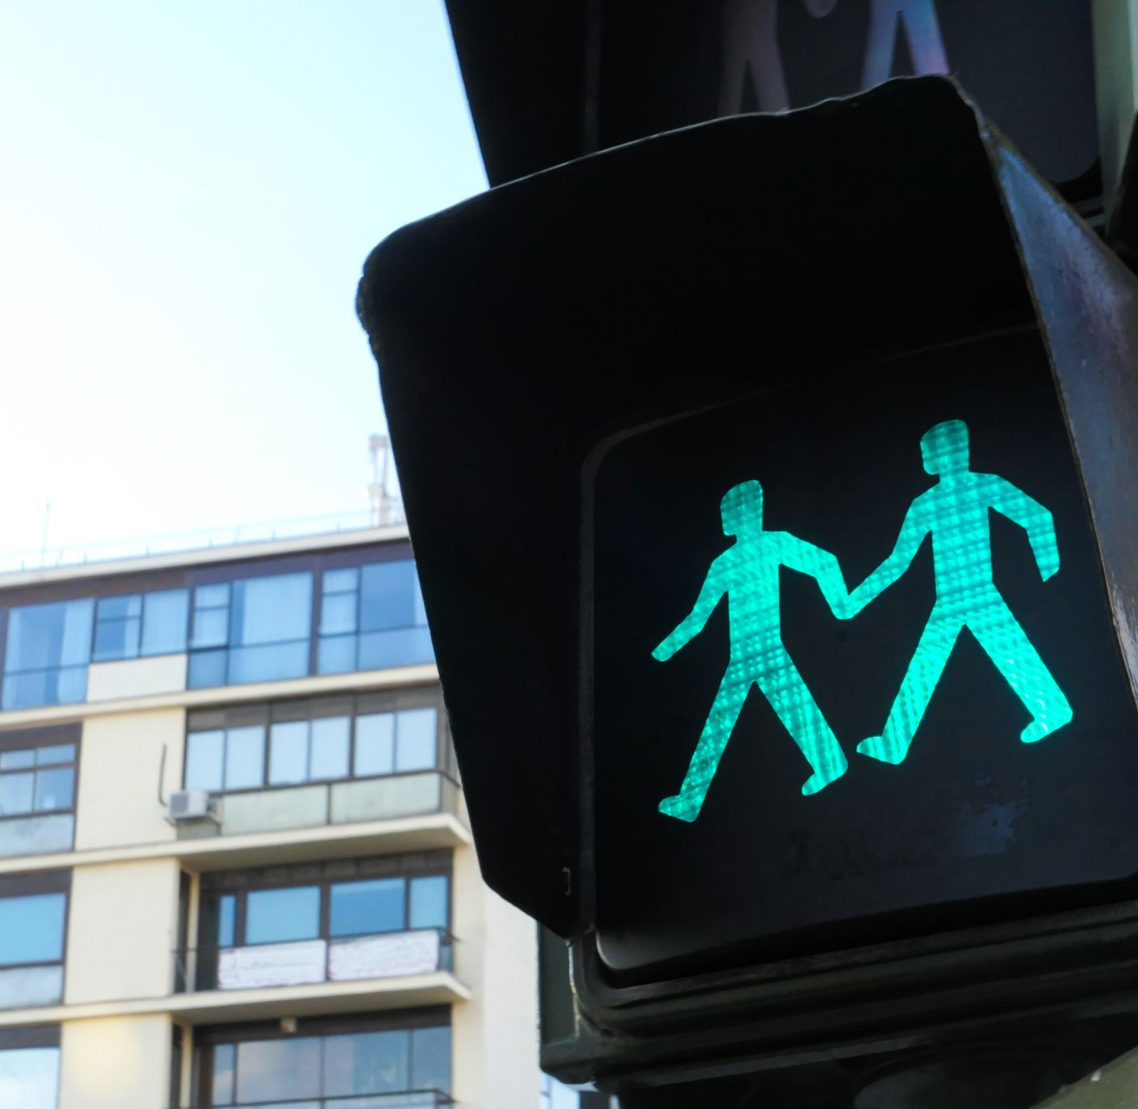
CEIS 114 Creating a Multiple Traffic Light Controller with a Cross Walk and an Emergency Buzzer with secured IoT Control via Web By: Kassandra Moreno

Slide 2
Introduction
In this presentation, you will find the creation of a traffic light system. My project was created using Arduino technologies and myDevices Cayenne services. It all started with the right pieces... And it ended with wifi-controlled emergency lights. Follow along and see how!

Slide 3
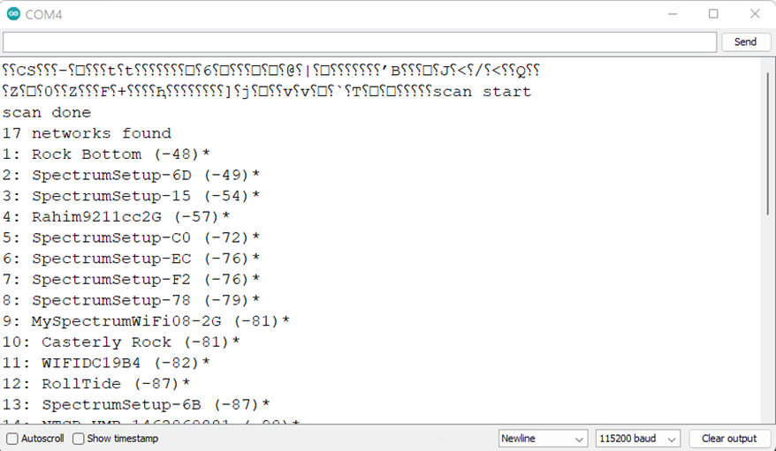
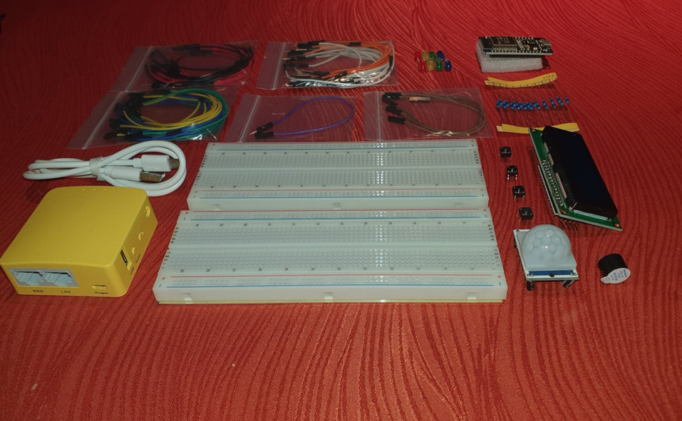
Project Necessities: - Inventory - Network availability check

Slide 4
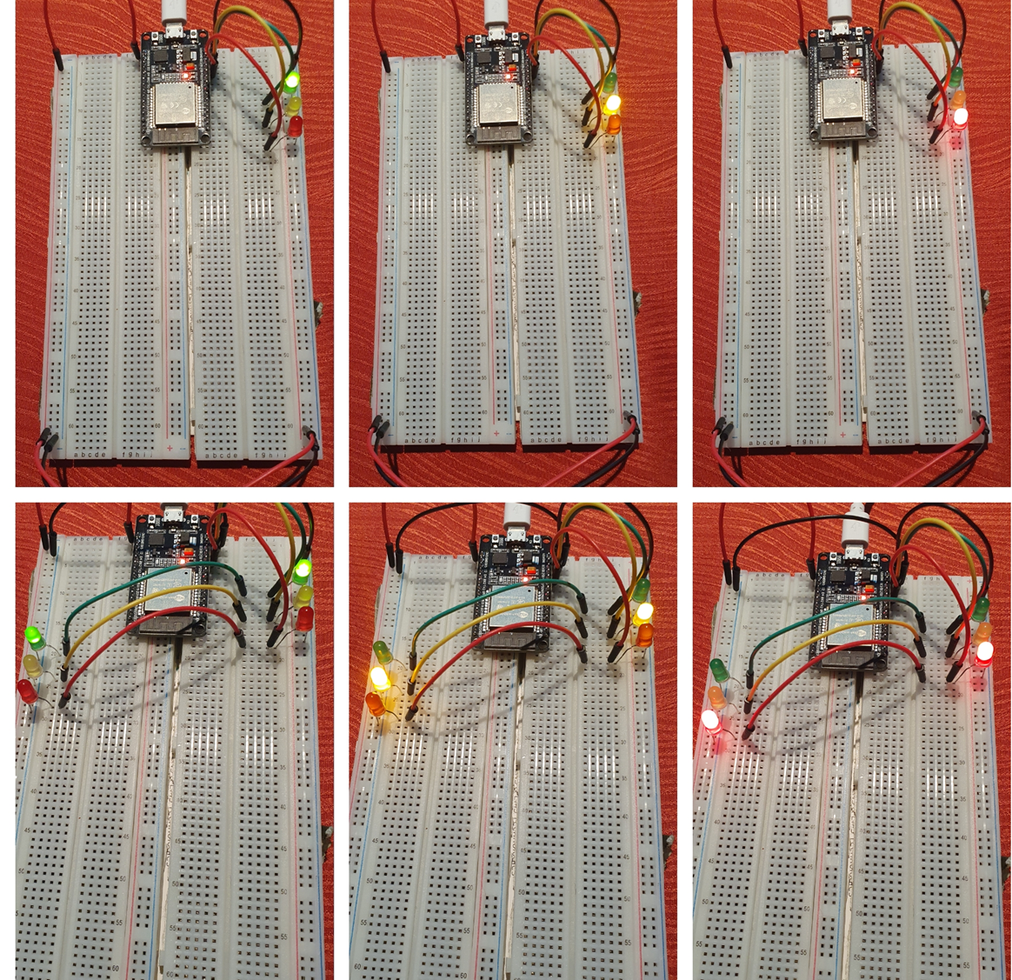
Camera, Action, Lights! - One traffic light - Two traffic lights (identical pairing)

Slide 5
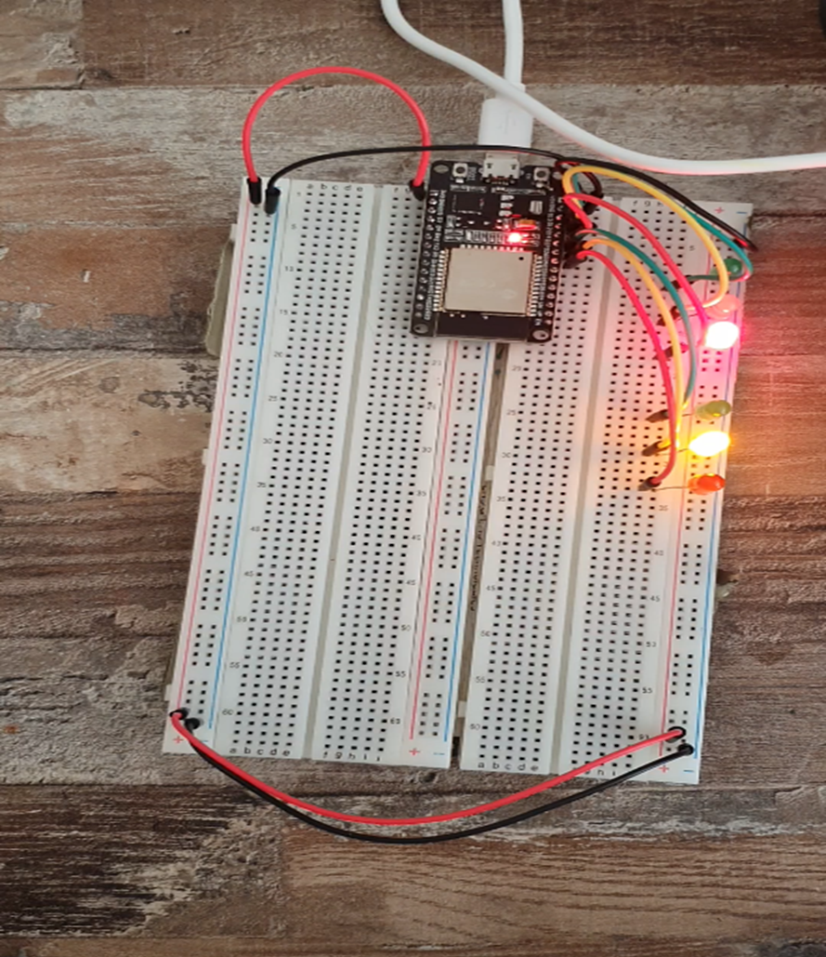
Camera, Action, Lights! (Part 2) - One traffic light - Two traffic lights (unidentical pairing)

Slide 6
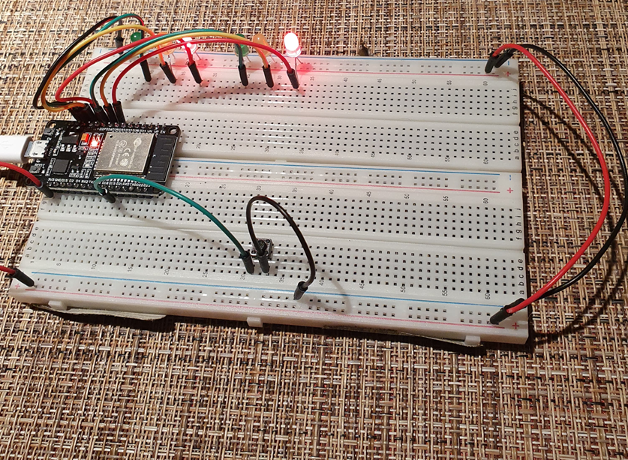
I’m Walkin’ Here - Crosswalk addition

Slide 7
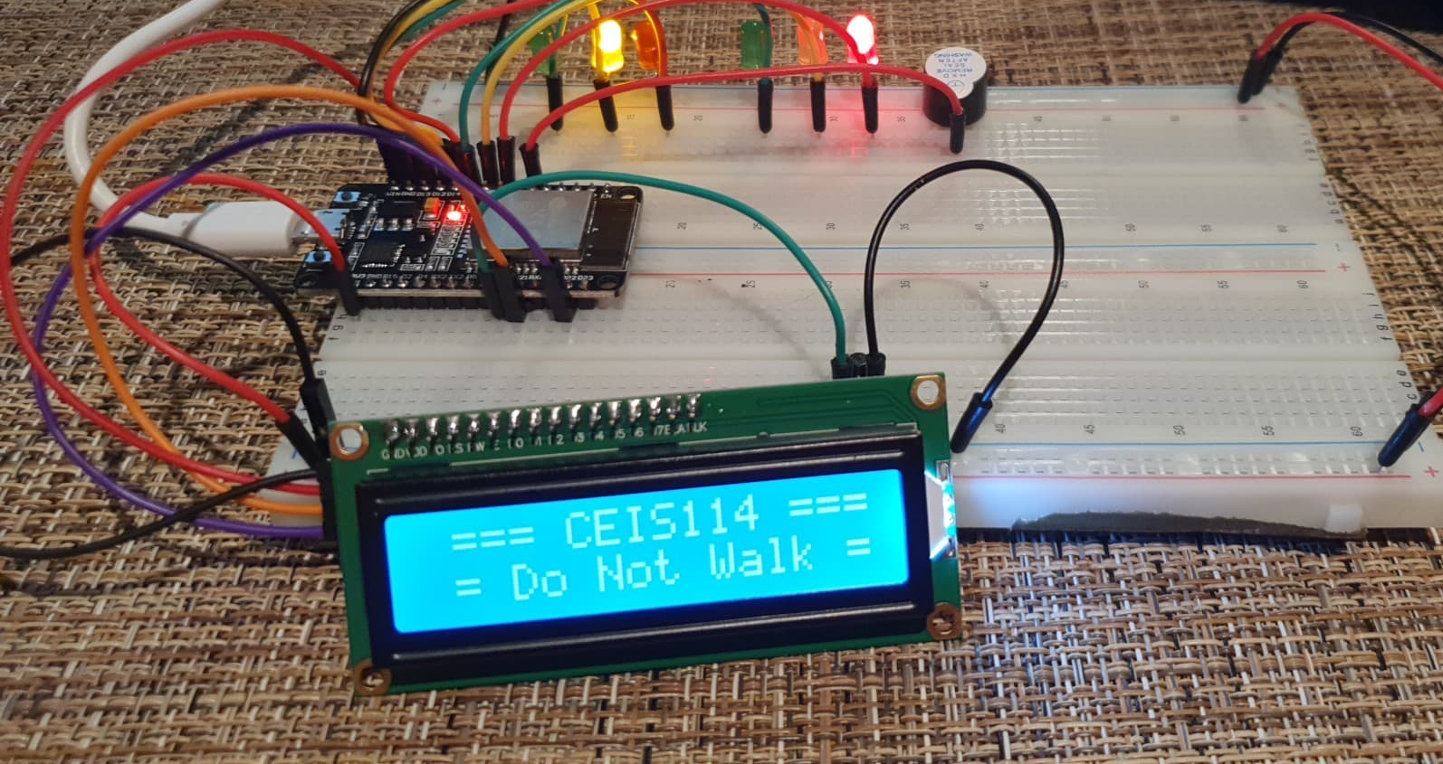

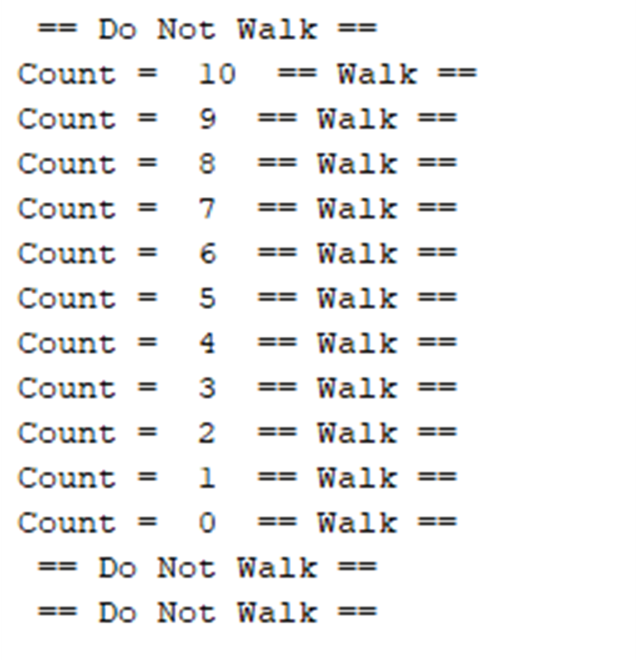
Emergency Buzzer -Audible buzzer countdown

Slide 8
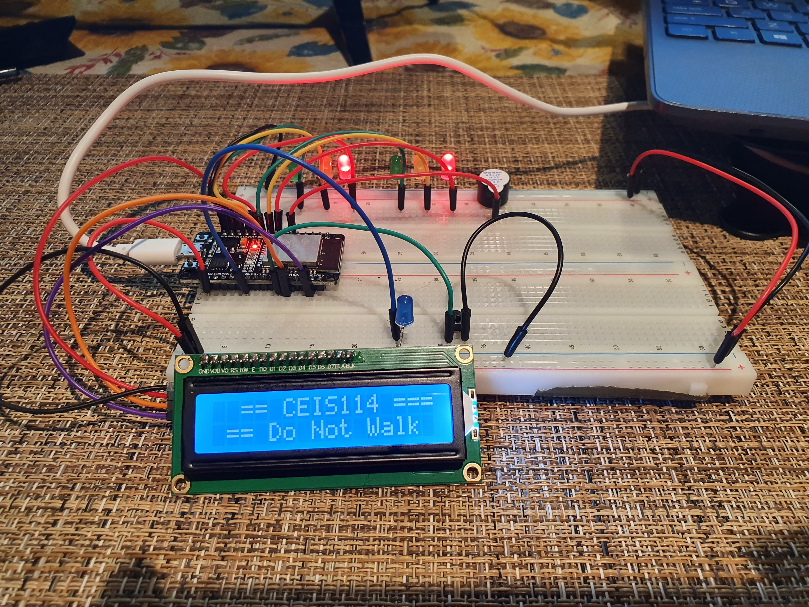
Wifi Emergency notification

Slide 9
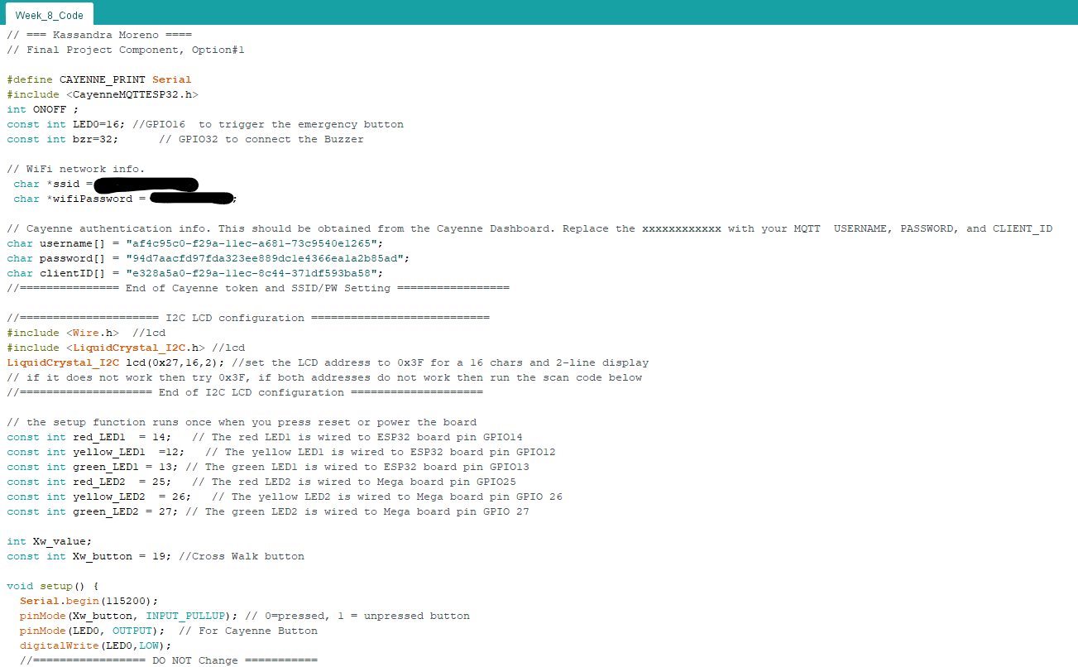
Arduino code

Slide 10
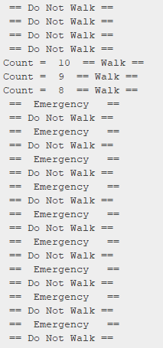
Wi-fi Emergency notification as seen on the serial monitor

Slide 11
Challenges As with all great projects, I had some challenges I needed to sleep on. While the project guidance looks pretty black and white, life is not always something that follows instructions as well as we want it to. My first difficulty was my USB connection. I couldn’t figure out why my code and device wouldn’t communicate. This challenge led me to learn something very valuable… Not all USB cables transfer data. I would say my biggest challenge was using myDevices Cayenne. I had difficulty understanding how to add devices outside of what I found instructions for.

Slide 12
Conclusion This project resulted in a traffic light system that included both a crosswalk operation and an off-sight emergency control system that operated under two unidentical traffic lights.

Slide 13
Career Skills As with all projects I have taken on this far in my early understanding of IoT networking and devices, I have many career skills I’ve acquired from this project. My favorite takeaway was learning how to locate and troubleshoot COM port settings on my Windows device through GUI and the command line. Though learning this was not strictly part of the project, it is one of the paths I took while trying to get my (wrong) USB cable to receive my code at the very beginning of this project.

